Slide 1

Multi-Fault Classification of Induction Motor by Machine Leaning Algorithms
Supragya Shrestha, Yashraj Vijay Molawade
BTP Supervisor: DR. RAJIV TIWARI
BTP CO Supervisor: DR. DR. D. J. BORDOLOI
Department of Mechanical Engineering
Indian Institute of Technology Guwahati
ME 499 BTP Phase II Presentation
22nd Apr 2021, IIT Guwahati, Guwahati, India

Slide 2
Plan of Presentation
Aim
Types of Faults in Induction Motor
Literature Review
Motivation and Objective of the Work
Binary Classification
Multi Fault Classification
Neural Network
Convolutional Neural Network
Recurrent Neural Network(LSTM)
Results
Conclusions
Future Work

Slide 3
Aim
Comprehensive Understanding of continuous and error free operation of Induction Motors.
Considering various state-of-the-art techniques to evaluate the merit of the models developed.
Improvement in performance of fault diagnosis using neural networks.

Slide 4
Types of Faults in Induction Motor
Faults in IM are broadly classified into two types :
Mechanical faults:
Bearing fault
Rotor related fault
Electrical faults:
Stator winding fault
Broken rotor bar faults
Phase unbalance and single phasing fault

Slide 5
Motivation and Objective of the Work
Based on the literature review it is observed that the faults in induction motor can be recognized prematurely and thus determined beforehand to avoid further losses.
However, all the studies were primarily devoted to studying machine learning algorithms such as SVM or deep learning models employed on a data in which the ratio of healthy to unhealthy motors was skewed heavily.
This motivates the need to study to study deep learning techniques applied
On such a dataset which is appropriately cleaned.
Objective of the Work
to study the effect of various DL techniques using data visualization and data preprocessing.
to identify a suitable parameters and hyperparametes so as to avoid overfitting and increase the accuracy over test dataset.

Slide 6
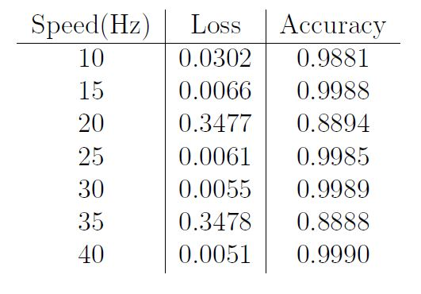
Binary Classification
The data was classified into two classes namely ‘defect’ and ‘no defect’ . The accuracy obtained was around ~90%.
This accuracy was rather higher than expected due to the fact of skewness of data.

Slide 7
Multi Class Classification
The data has 10 classes representing different types of faults occurring in the motor and also a class depicting a healthy motor.
Since the data we have has missing columns, we pre-processed the data in two ways; one by completely removing the particular feature from the entire dataset, another by removing that particular fault from the entire dataset.
We have used the following deep learning methods to accomplish this task:-
Convolutional Neural Network
Recurrent Neural Network
Neural Network

Slide 8
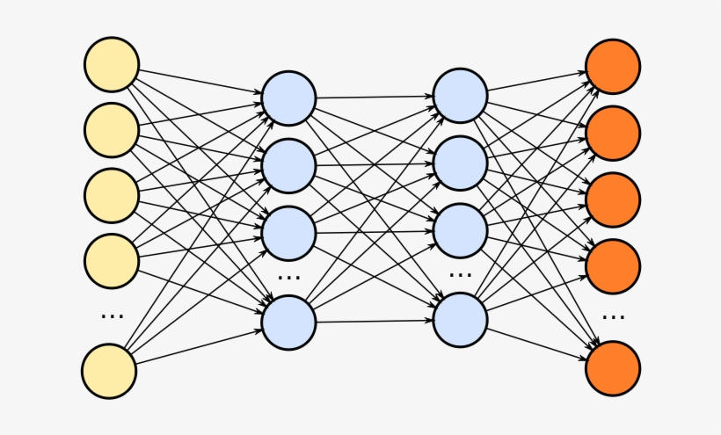
Neural Network
In this model we have 4 fully connected hidden layers and an output layer, alongwith 2 batch-normalization layers.
Hidden layer activation function as ReLU.
Last output layer has activation function of softmax.
Categorical cross-entropy as its loss function.
Labels are encoded using a one-hot encoding scheme.

Slide 9
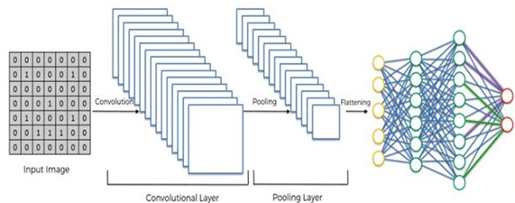
Convolutional Neural Network
CNN is specifically used for heavier datasets such images and thus we can use the same here also.
This CNN has 8 layers in total
It takes input of dimensions 100X9 depicting 100 consecutive data-points.
First 6 layers perform convolution as well as max-pooling.
Last two layers are fully connected dense layers.
Output is one-hot encoded vector depicting all 11 classes.

Slide 10
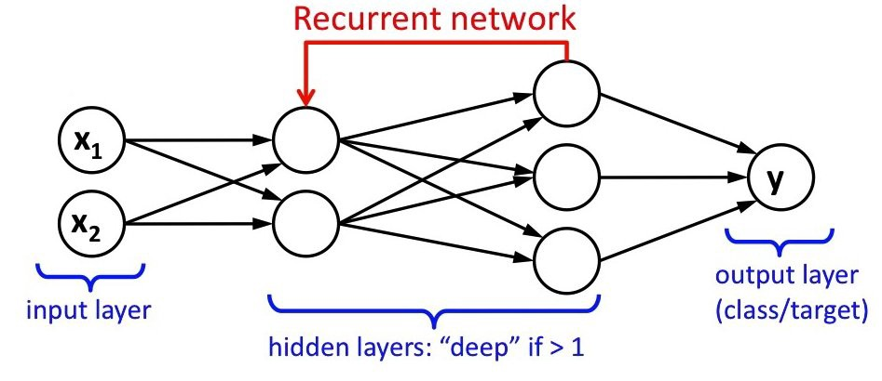
Recurrent Neural Network(LSTM)
Since the data is sequential, using LSTM is a viable approach
The model structure is similar to that used in the CNN above with the layers of convolution and pooling replaced with layers of LSTM and Dropout.

Slide 11
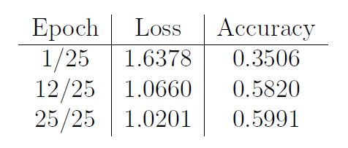
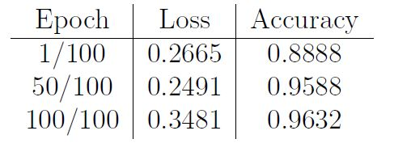
Results
Neural Network :- The accuracy starts at 35% and gradually increases with each training up till 60%. When the model was run on test data, it gave accuracy of 0.6112 or approximately 60%.
Convolutional Neural Network :- Accuracy gradually increased with each
epoch by starting from 88% and stabilizing at 96%

Slide 12
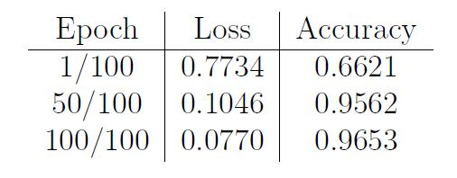
Results
Recurrent Neural Network :- Results with the LSTM also showed high accuracy over training as well as testing data. The accuracy on test data is 0.9653 or 96%.
In NN, the f1-score is low for labels 0-6.
In LSTM, the precision, recall and f1-score values for all the labels are close to 1.
In LSTM, the precision, recall and f1-score values for all the labels are close to 1.

Slide 13
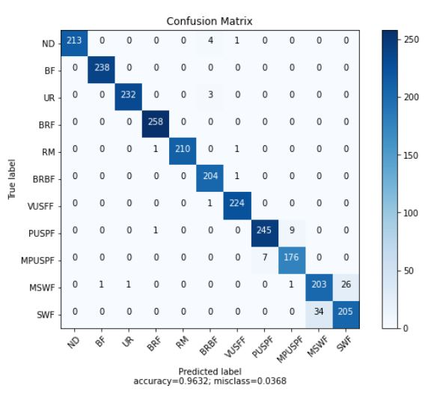
Results
Confusion Matrix for all the 11 Classes for CNN

Slide 14
Conclusions
Basic neural network gave accuracy much lesser than CNN and LSTM.
For Basic neural network the f1-score is low for labels 0-6 indicating that the model is not performing better in predicting those values.
So in comparison to a simple NN, CNN performs much better as the given data is large(4498000 rows X 10 columns).
LSTM is a type of RNN which helps in processing this sequential data and thus performs even better.

Slide 15
Future Work
The models designed so far have been compiled on a specific set of learning rate, number of epochs, hidden layers and neurons. They have not been trained for different set of such parameters and so we can still do hyper-parameter tuning to gain more insights into our models.
The model has been trained on discrete set of frequency values. We can further collect
data having frequency as a time variable parameter and use the same to train our model for better predictions.
Since we got one of best accuracies for LSTM model, which is a sequential model, we can train on state-of-the-art sequential models such as BERT(Bidirectional Encoder Representations from Transformers) to further improve the performance of the model.

Slide 16
Thank You !
Any Questions?

